Slide 1
Making changes

Slide 2
Kotter’s 8 steps…

Slide 3
1. “Create a sense of urgency”
What is the current situation and why must it change?
How could you do this for your emergency laparotomy patients and NELA standards?

Slide 4
2. “Create a guiding coalition”
You can’t improve this on your own- who do you need to recruit to your improvement team?

Slide 5
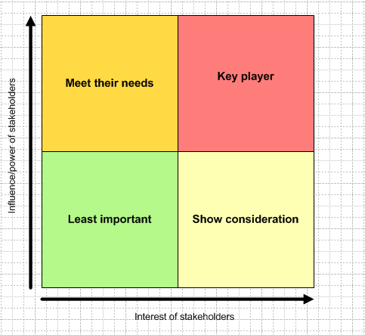
Plan and analyse: e.g. Stakeholder map

Slide 6
Breakout
Who is interested in your NELA improvements?
Try to list them and think about how you might influence them

Slide 7
3. “Create a vision for change”
What are your goals? How will that look for patients?

Slide 8
Negotiate and influence
Who do you need to influence?
What is in it for them?
What position will they adopt?
What will they want to know?
Have you got a clear message?

Slide 9
4. Enlist a volunteer army
How will you win others over to your ambition?
Who do you need to do the work?
What will motivate them to change?

Slide 10
What interventions work? Cochrane review of interventions that lead to clinical behaviour change-
Examples of interventions Bero et al 1998 | How effective?
Multifaceted interventions, reminders, interactive educational meetings | Consistently
Feedback of clinical performance, local opinion leaders | Variably
Lectures, distribution of recommendations | Not effective
Notes:
10
Also Jamtvedt et al 2007 – feedback to staff needs to be intensive. Tends to be easier to push change through when adherence to practice is low (back to 80/20 rule). So better the results, the more facilitator has to work.
Keep doing them – not just one at the beginning but after change has started.
~Engagement of senior leaders is a significant factor in sustaining improvement (Ham 2003)
One way of producing interventions in the consistently effective bracket, would be to give reminders at these interaction CG meetings on an ongoing basis. May be lead for the uadit could report back on action plan progress.

Slide 11
5. Help action by removing obstacles
What is stopping improvement now?
Who can you speak to in the organisation about what you need and why would they help you?
(remember NELA is part of CQC inspections and laparotomy care costs ++ money)

Slide 12
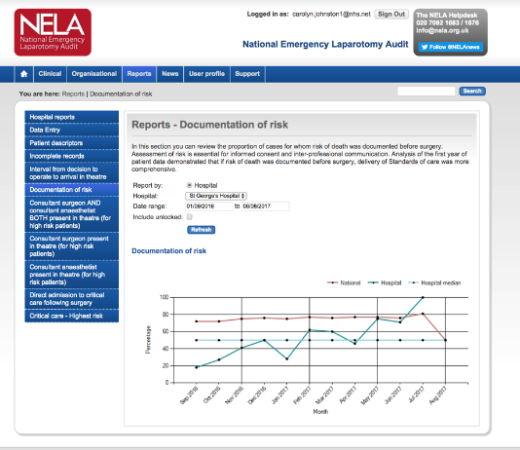
6. Create short term wins
Start with something easy to build momentum.
How can you use the NELA data to recognise and reward improvements?

Slide 13
7. Sustain acceleration
Push hard after any initial successes, you are increasing your credibility to make things happen!

Slide 14
Institute change
Modify hospital policies and procedures to incorporate your changes- e.g. do you need to include in education, new paperwork and induction programmes?

Slide 15
Any questions?

